Slide 1
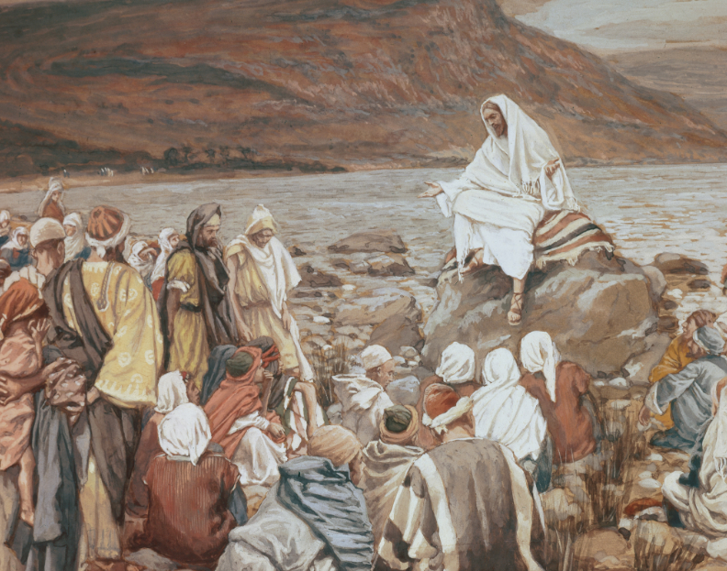
Mistakes & Decisions Where Grace Begins and Ends

Slide 2
ACTS 5 : 1 - 16
. . . a clean church . . .

Slide 3
Was this a righteous judgement?

Slide 4
“Unlimited grace” is not a biblical doctrine.

Slide 5
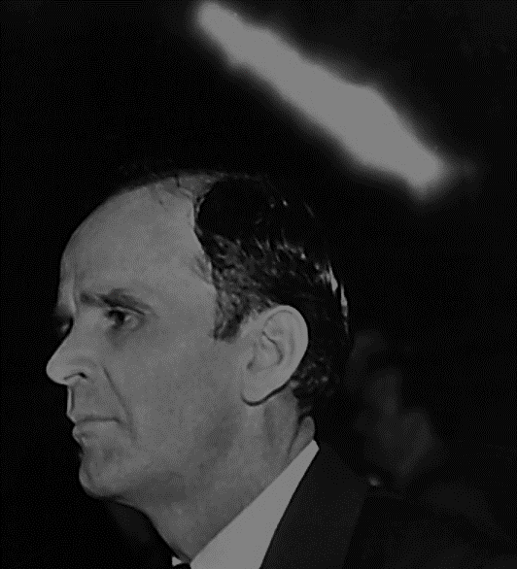
63-1115 The World Is Falling Apart
147 We wonder today, what, why the gifts and things are not in the church, operating the way they should be. Why, the gifts are put in the church, to separate and take sin out, to keep the church clean. It’s God’s toxin that’s given to the church. …

Slide 6
63-1115 The World Is Falling Apart
… It’s God’s…also His disinfect that He puts into the church, to kill out all the parasites that tear up the church. And God sprays His church over, with His Word. And that keeps all the termites out, you know, so the church can grow, a plant. And God knows what it takes to do it.

Slide 7
65-1212 Communion
60 You know, the hour will soon arise when right among us will be…the Holy Spirit will speak out like It did in Ananias and Sapphira. Remember, see, that hour is arriving. See? And we are…Now, you just remember that, see, that God is going to dwell among His people. That’s what He wants to do now.

Slide 8
65-0427 Does God Change His Mind?
Something went wrong. Nothing wrong with Christ, see, but something went wrong. Something is somewhere. The pulpit, used to, wouldn’t have permitted such a thing as that, but it does now. See, the crisis is on, and we’re missing something.

Slide 9
65-0427 Does God Change His Mind?
129 We’re missing power that we ought to have, where the big machine ought to be running up, and great signs and wonders. Well, this building ought to be sitting so full of power of God, now, till a sinner couldn’t stay in here; …

Slide 10
65-0427 Does God Change His Mind?
… the Holy Spirit condemning it, right quickly like that, like Ananias and Sapphira. And we’re missing something.

Slide 11
EPHESIANS 6 : 12 - 13
. . . we wrestle not . . .

Slide 12
AMOS 3 : 3
Can two walk together, except they be agreed?

Slide 13
Mistakes vs Decisions

Slide 14
Your
Life

Slide 15
Your
Life

Slide 16
Your
Life

Slide 17
Your
Life

Slide 18
Your
Life

Slide 19
Your
Life

Slide 20
Your
Life

Slide 21
Your
Life

Slide 22
Your
Life

Slide 23
A smoker in my house?

Slide 24
TRUTH will make free!

Slide 25
64-0205 God Is His Own Interpreter
143 Do you believe out there? You believe it’s Jesus Christ? What is it? It’s His Word. When these people reject It, they’re not rejecting a man, they’re rejecting the Word. It’s the Word that was on the outside, couldn’t get back in.

Slide 26
63-0607 Be Not Afraid
143 I used to go around with an old Methodist circuit rider, he would sing a little song for me:
We let down the bars, we let down the bars,
We compromised with sin.
We let down the bars, the sheep got out
But how did the goats get in?

Slide 27
The Pearl Highway

Slide 28
The Last Call

Slide 29
59-1001 What Went Ye Out To See?
61 You can’t help being what you are. Even if you’re a sinner, you’re not responsible for being a sinner. You’re responsible for remaining a sinner. There is a way prepared for you. But to be a sinner, you was born that way. God doesn’t send you to hell for being a sinner. God sends you to hell because you won’t repent and take Christ as your Saviour.

Slide 30
59-1001 What Went Ye Out To See?
You refuse to take the right road. You send yourself to torment. You send your own soul to its Eternal destination, upon the free moral agency of your own convictions. God does not send anyone to hell. He never did and He never will. Men send themselves to hell because they refuse to accept the way of salvation.

Slide 31
Sometimes we are calling when the Spirit isn’t.

Slide 32
Decisions vs Mistakes

Slide 33
Mistakes & Decisions Where Grace Begins and Ends

